Slide 1
mRNA Quality Control

Slide 2
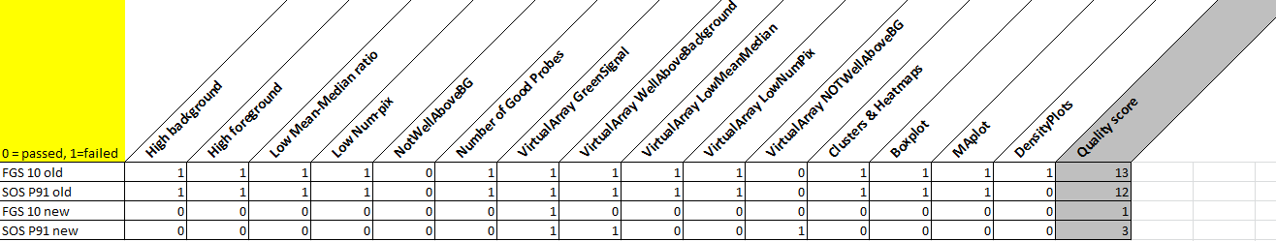
mRNA Quality Control overview (arrayQC)
Sample FGS10 and SOS P91 were re-ran → clear improvement of quality

Slide 3
Pipeline after QC / Normalization
Extraction software
Quantile normalised and flagged file from ArrayQC
Flags
Removal of control spots
GenePattern
Imputing missing values
Babelomics
Merging replicates , median method
Agilent reanno-file
Re-annotation ; probeID → EntrezGeneID (file: 039494_D_AA_20120628)
Spot flags QC
Removal of flagged spots; <=25% flags allowed across dataset
ImputeMissingValuesKNN; KNN, k=15
~63000 probes
~ 59000 probes
~ 50000 probes
~ 22000 probes
~ 18000 probes

Slide 4
Defining differentially expressed genes
DataFile
~ 18000 probes
Splitting
Split FGS and SOS data (with corresponding controls)
Grouping
Split FGS data further into cholestatic (9), drained (10) and control (9)
Calculate Ratios
Calculation of log-ratios → For each mRNA: mean(treated) – mean(control)
DEG
Selection of differentially expressed mRNAs
FGS 28 samples, SOS 20 samples
48 samples
Split SOS data further into SOS (10) and control (10)
Criteria: p.value < 0.05 and |FC| >= 1.5
Unpaired t-test → SOS, FGS or drain vs. control

Slide 5
miRNA Quality Control

Slide 6
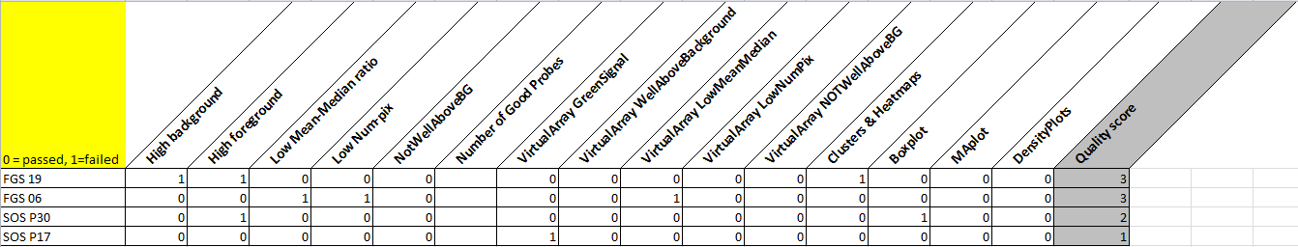
miRNA Quality Control overview (arrayQC)
Sample FGS19 was hybridized again → improvement of quality

Slide 7
AgiMicroRna pipeline
dd.micro
62344 probes
ddTGS
Summarized into 2027 miRNAs (± 30 probes per miRNA)
ddNORM
Normalized data on 2027 miRNAs / internal controls
ddPROC
Filtered data (QC), 507 miRNAs remaining
esetPROC
Expression set, 507 miRNAs
48 samples
48 samples
48 samples
48 samples
48 samples
DataFile
Remove bad samples for further analysis (not performed in this study)
48 samples remaining

Slide 8
CalculateRatios pipeline
DataFile
507 miRNAs
Splitter
Split FGS and SOS data (with corresponding controls)
Grouping
Split FGS data further into cholestatic (9), drained (10) and control (9)
Calculate Ratios
Calculation of log-ratios → For each miRNA: mean(treated) – mean(control)
DEG
Selection of differentially expressed miRNAs
FGS 28 samples, SOS 20 samples
48 samples
Split SOS data further into SOS (10) and control (10)
Criteria: p.value < 0.05 and |FC| >= 1.5
Unpaired t-test → treated vs. control
miRNA is skipped if > 75% of datapoints in group is NA

